Slide 1
Pharma

Slide 2
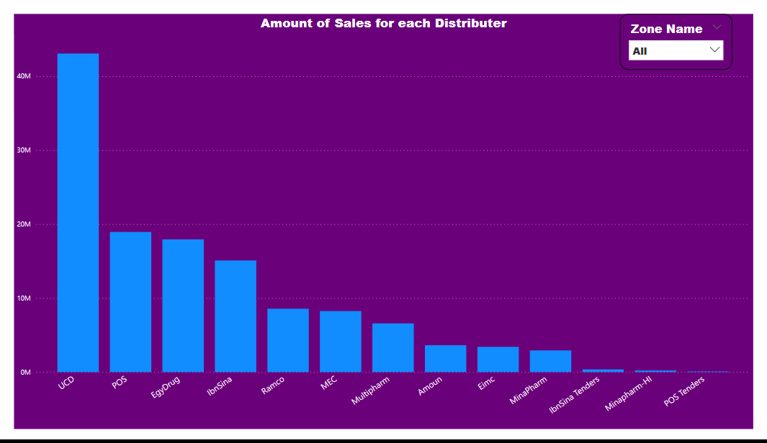
Q1: Which distributor is the best for each zone
We can see from the graph that:
UCD distributor has the most sales amount for all zones, Followed by POS and EgyDrug.
Ibn Sina tenders, Mina pharm-HI, and POS tenders have the lowest sales

Slide 3
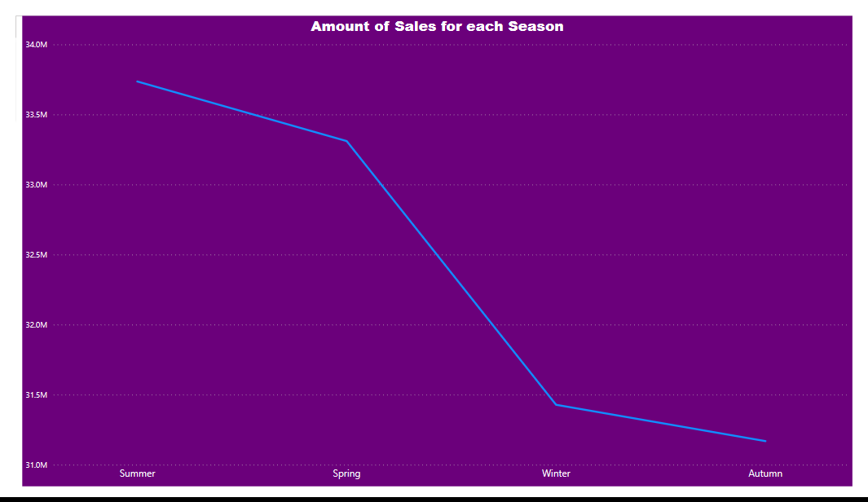
Q2: Sales amount according to the season of the year
This graph represents the sales amount over the year’s four Seasons.
The sales peak in Summer & Spring, while in Winter & Autumn, it’s too low.

Slide 4
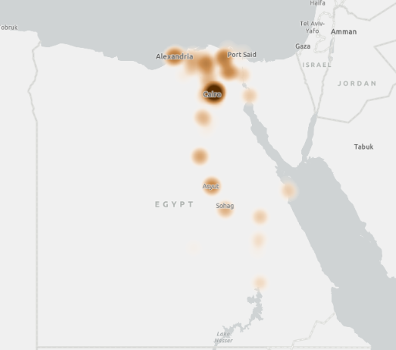
Q3: Does the region have an impact on product Sold
This map shows the volume of sales for each region.
The color is a scale from white to brown, The darker color represents a huge sales amount, and the color becomes paler when the sales amount decreases.
So, we can see that Cairo has the most sales As It has the largest population density, while Aswan and some cities in upper Egypt have the lowest sales because of their low population density.
So, we can assume that region may have an impact on Sales or Products sold.

